Slide 1
Sharp x47 Cash Register Series
2012
Sharp Electronics Corporation

Slide 2
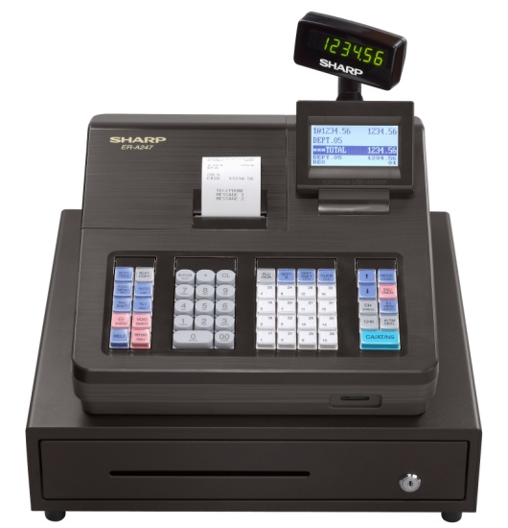
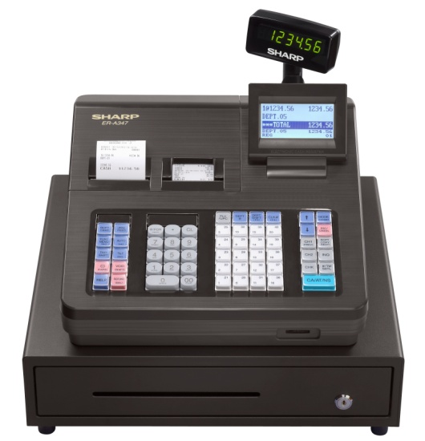
New Models for 2012
ER-A247
Special Features:
2,500 PLU’s
53 Keys
ER-A347
Special Features:
7,000 PLU’s
59 keys
Dual Receipts

Slide 3

Model Highlights!
Simple menu based Programming
Large 5/8 Line Displays
Stylish & Durable Design
PC Data exchange via SD card
PC Support Tool
Programming
QuickBooks Export
XML Files

Slide 4
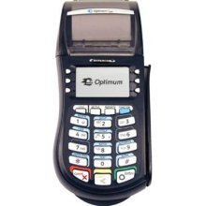
ER-A247 Serial Connection
ER-A247
1 x RS232 Port
Hypercom T4220
(w/ Serial cable)
Integrated EFT solution on low cost ECR*
+
=
*For use with processors with Class A/B certification to Hypercom application 3.3

Slide 5

ER-A347 Serial Connection
MS Scanner
(w/ 53601A Cable)
ER-A347
2 x RS232 Ports
Scanning Retail solution with EFT on low cost ECR*
+
=
Hypercom T4220
(w/ Serial cable)
*For use with processors with Class A/B certification to Hypercom application 3.3

Slide 6
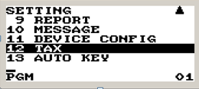

Class Leading Display
Allows:
Menu based settings and operation
Easy for merchant training
Easy cashier operations
Ability to Change Language (En/Sp)

Slide 7
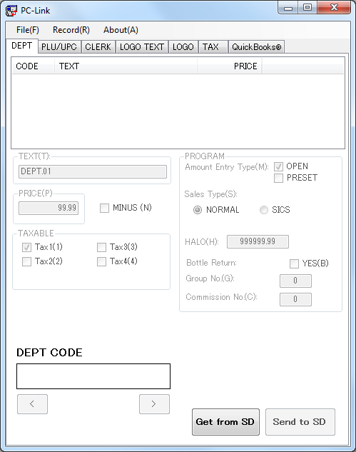
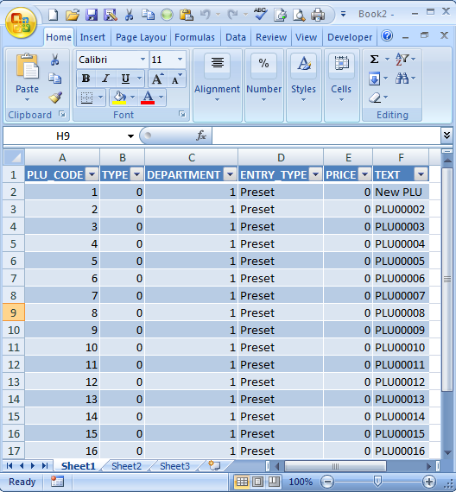
PC-Link Software
Excel settings from XML file
Dept / PLU / Tax & Cashier programming
Business Logo Text or Image loading
QuickBooks® Export

Slide 8
Feature Comparison - Hardware
Model / Func | ERA247 | ERA347
Operator display | 5 line ops / 8 mode | 5 line ops / 8 mode
Customer display | 1x7 | 1x7
Keyboard | 53 | 59
Printer Size Graphic Logo Journal Validation | 1 station Thermal 58mm Yes Yes No (E-journal) No | 2 station Thermal 58mm Yes Yes No
Drawer (Bill/Coin) | 5 / 6 | 5 / 6
SD Card support | Y | Y
RS232 Port(s) | 1 | 2
Battery | AA | Recharge

Slide 9
Feature Comparison - Entries
Model / Func | ERA247 | ERA347
Sales entry (max) Dept PLU | 99 2,500 | 99 7,000
Commission group | Y | Y
Discount (-$) (%) | 1 2 | 1 2
Taxes (% or Table) Tax delete Doughnut tax | 4 Y Y | 4 Y Y
Media Cash Check Charge EFT | 1 1 1 Y | 1 1 2 Y
SICS SIF | Y - | Y -

Slide 10
Feature Comparison - Functions
Model / Func | ERA247 | ERA347
Cashier Secret code | 25 Y | 50 Y
Manager (method) | 1 (code) | 1 (code)
Food Stamp | - | -
RA | 1 | 1
PO | 1 | 1
Currency conversion | 1 | 1
Auto-key | 1 | 1
Training mode (use) | Y (Cashier) | Y (Cashier)

Slide 11
Feature Comparison - Other
Model / Func | ERA247 | ERA347
Programming (type) | Menu | Menu
SRV Programming File Allocation | Ltd - | Ltd -
Language selection English Spanish | Yes Yes | Yes Yes
Onboard help | Yes | Yes
Dealer contact information | Yes | Yes
Scanner (option) | No | Yes
EFT (option) | Yes | Yes
PC software (option) | Yes PC-Link (free) Excel import/export | Yes PC-Link (free) Excel import/export

